Slide 1
Applied Physics EE (117)
LECTURE # 1
DATE: 16TH SEPTEMBER, 2019

Slide 2
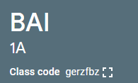
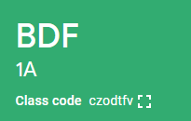
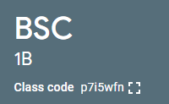
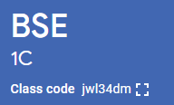
Classes Code

Slide 3

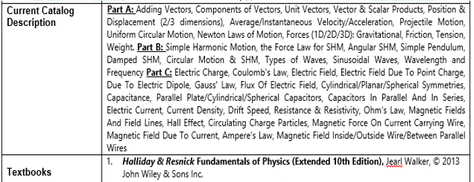
Applied Physics

Slide 4
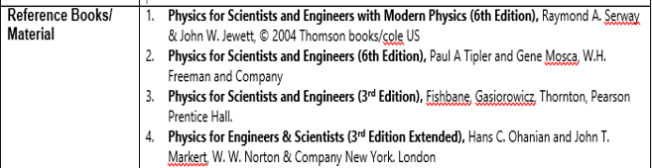
Applied Physics

Slide 5
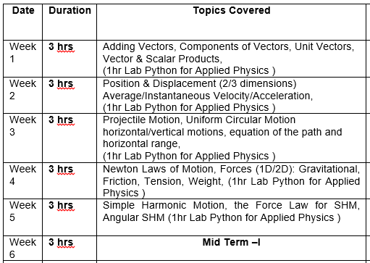
Applied Physics
Week-Wise Course Outline:

Slide 6
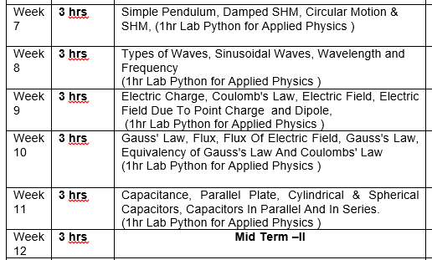
Applied Physics
Week-Wise Course Outline:

Slide 7
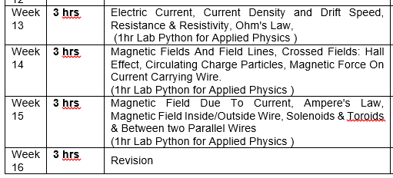
Applied Physics
Week-Wise Course Outline:

Slide 8
Applied Physics
Marks Distribution
Midterms | 30%
Lab | 10%
Class Quizzes + projects | 10%
Final Exam | 50%
Total | 100%

